Slide 1

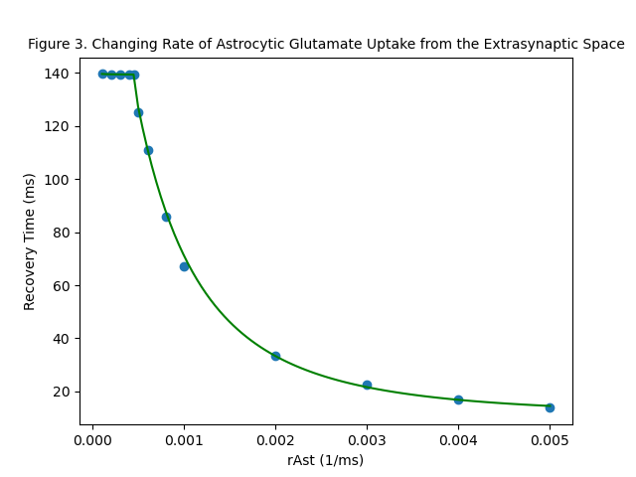
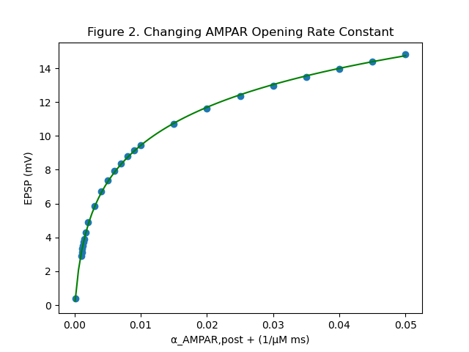
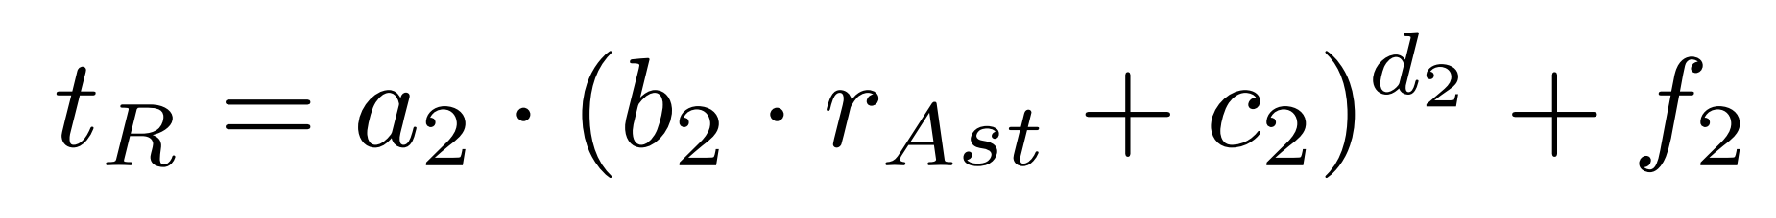
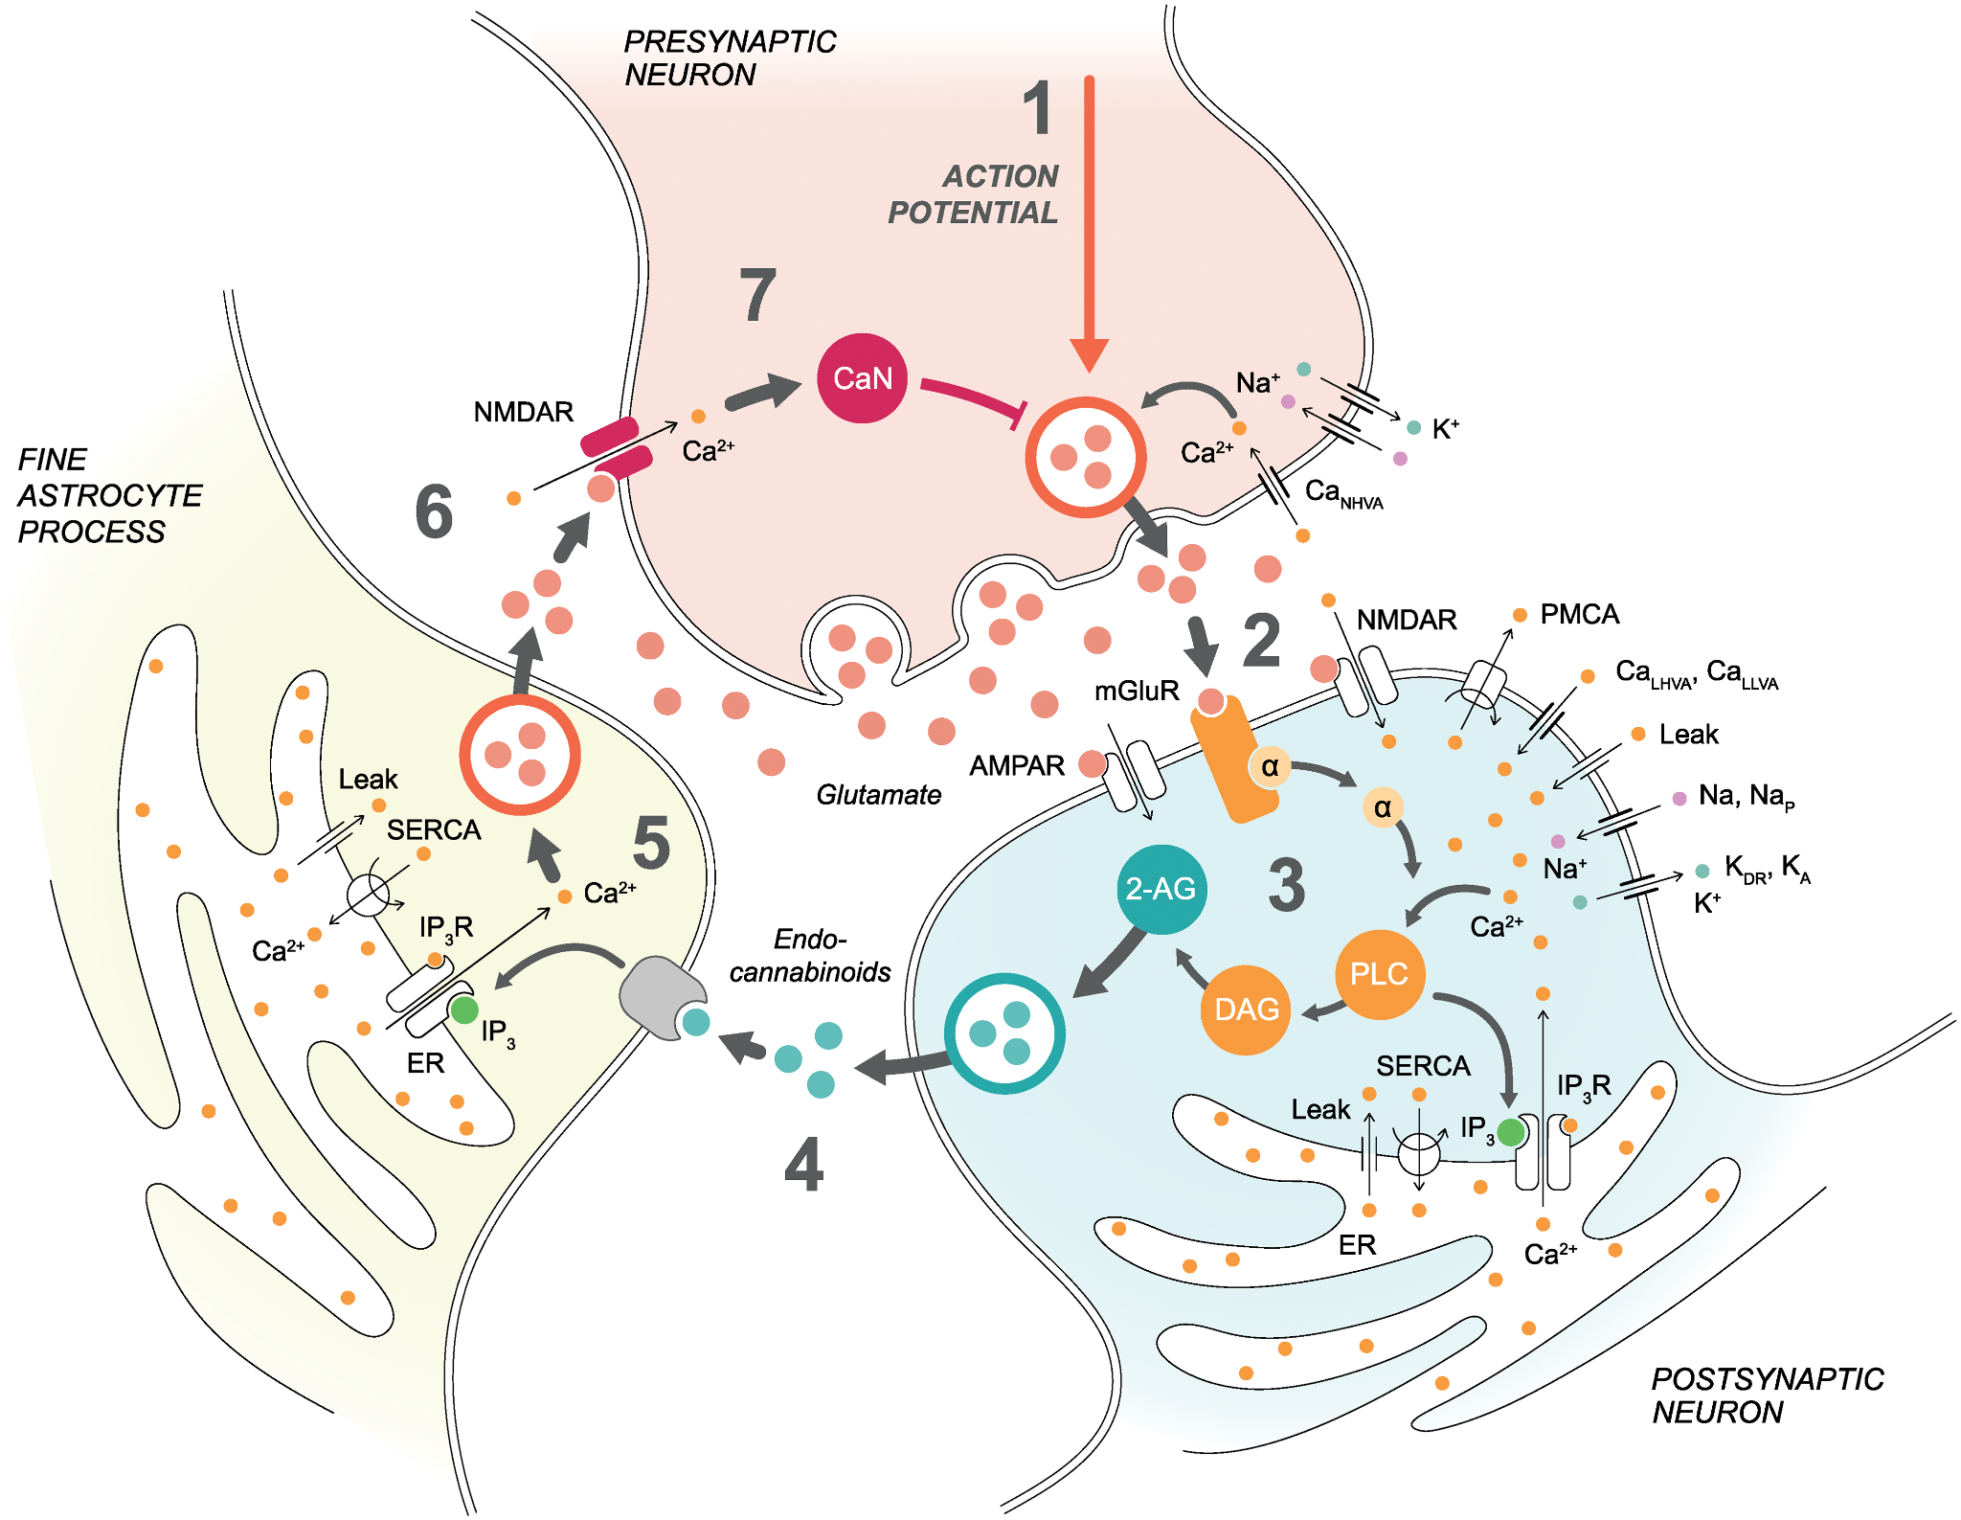
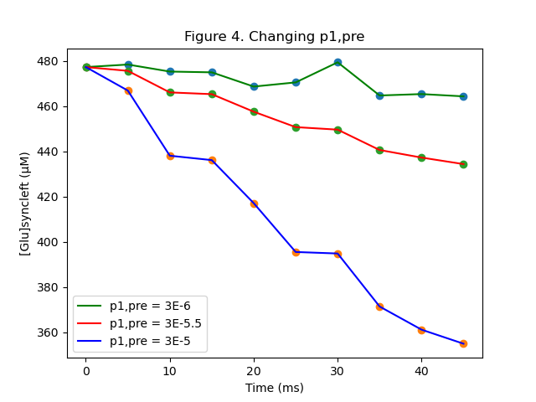
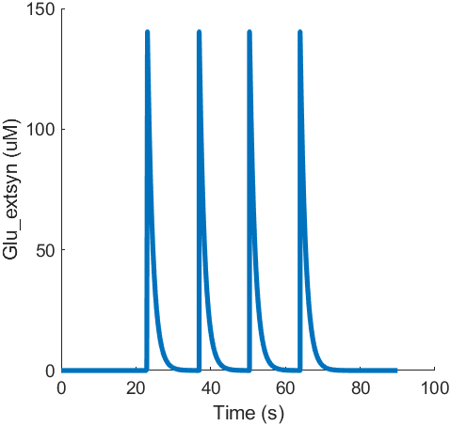
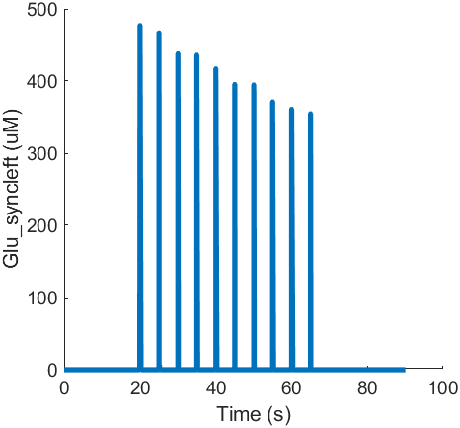

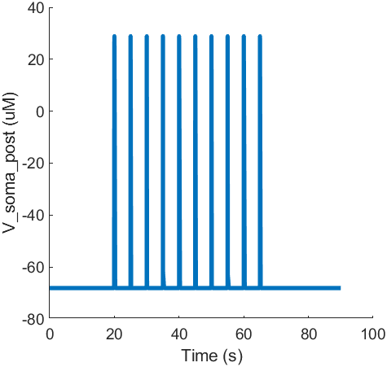
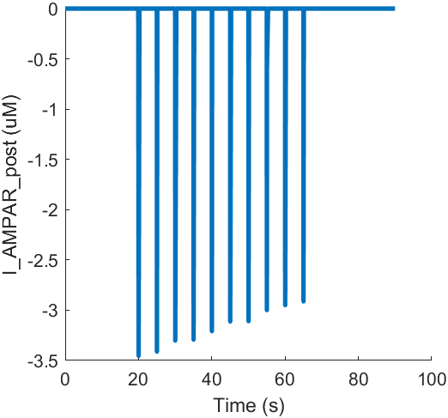
3
In Silico Analysis of Dysregulated Glutamate Dynamics in the Somatosensory Cortex after Traumatic Brain Injury
Jay Dalal¹, Howard Ji², Arnav Khanna³, Eloise Kipnis⁴, and Shreya Satheesh⁵
Homestead High School, Cupertino, CA 95014¹, University High School, Irvine, CA 92612², The Academy for Health & Medical Sciences, Bridgewater, NJ 08807³, Cherry Hill High School East, Cherry Hill, NJ 08003⁴, Cumberland Valley High School, Mechanicsburg, PA 17050⁵
Introduction
Results
Traumatic Brain Injuries (TBI) affect 2.5 million people and causes 80,000 to be permanently disabled each year in the United States.
Hebbian Plasticity refers to when neurons fire in sync to form networks and transmit information. This process in moderation increases synaptic strength amongst neurons. Spike Time Dependent Plasticity (STDP), a form of hebbian plasticity, is increased in TBI to an unstable level.
However, after TBI, astrocytes become reactive, releasing glutamate into the space between neurons and decreasing the rate of its glutamate uptake. This causes AMPA receptors (AMPAR), a type of glutamate receptor, to increase on the postsynaptic neuron.
Because synaptic and extrasynaptic glutamate concentration surge, excess concentrations of calcium build up intracellularly. This process is known as excitotoxicity.
Objective: Investigate the specific effects of dysregulated glutamate dynamics associated with TBI
(Fig 2; Eq 1). As AMPARs open at a faster rate than they close, overall AMPAR current increases and EPSP increases. The logarithmic trendline of this relationship (R² = 0.9996) is shown below, where a₁, b₁, c₁, and d₁ are fitting parameters.
(1)
(2)
(Fig 3; Eq. 2). Interestingly, this model suggests that decreased astrocytic glutamate uptake has no effect on EPSP. However, we did model the relationship between uptake rate and the recovery time (time it took for glutamate levels to fall back to resting levels) where t_{R} is the recovery time and a₂, b₂, c₂, d₂, and f₂ are fitting parameters. Note that values of r_{Ast} < 0.0045 (R² = 0.9892), has different fitting parameters for the equation than values of r_{Ast} ≥ 0.0045 (R² = 0.9971).
Figure 1 - Tripartite Synapse
Manninen T, et al.
(Fig 4). This model suggests that p¹_{pre} has no effect on EPSP. We modeled the relationship between p¹_{pre} and glutamate in the synaptic cleft. This demonstrates that with lower p¹_{pre}, glutamate stays in the synaptic cleft longer, which may have excitotoxic effects.
A
Figure 5
B
Methods
C
D
Our analysis builds upon a model outlined in Manninen et al., 2020:
Simulates a tripartite synapse (a presynaptic neuron, postsynaptic neuron, and an astrocyte) in the somatosensory cortex.
Uses a biophysically plausible conductance-based dynamical system of equations
We made the following perturbations to account for acute changes in TBI:
Increasing the postsynaptic AMPAR opening rate constant (α_{AMPAR,post} )
Decrease the glutamate uptake rate of the astrocyte (r_{ast})
Decrease the rate constant for presynaptic protein activation inhibiting glutamate vesicular release (p¹_{pre})
We calculated EPSP, an indicator for synaptic plasticity, for each simulation by subtracting the minimum V_{post, som} from the max V_{post, som}:
If EPSP were unchanged, we measured other aspects of glutamate levels, such as extrasynaptic and synaptic glutamate concentration.
Using nonlinear regression techniques, we developed trendlines to mathematically model the effects of AMPAR and r_{Ast}.
(Fig 5). Representation of Common Glutamate Related Variables in the Model Over Time (A) Extrasynaptic Glutamate Concentration (B) Synaptic Cleft Glutamate Concentration (C) Membrane Potential in the Postsynaptic Soma (D) Current of Postsynaptic AMPAR.
Discussion
Future Work
Conclusions
The model is supposed to simulate synaptic depression. Our perturbation to AMPAR shows an increase in EPSP to unsustainably high levels that disrupt homeostasis.
According to this model, causing excess glutamate to remain in the synaptic cleft or extrasynaptic space has no effect on EPSP or overall decline in synaptic strength, which contradicts previous experimental biology studies.
Applications
Demonstrate that glutamate dynamics play a crucial role in maintain synaptic strength and homeostasis and that TBI undermines these processes.
Suggests the necessity to further explore and model the effects of perturbations to glutamate dynamics.
Open avenues for short-term therapies that target glutamate, which may potentially reduce chances of permanent disability and neurodegeneration after TBI.
Limitations
Our model did not account for the whole neural circuit, only highlighting the two neurons in the tripartite synapse.
We also did not include all aspects of glutamate dynamics, specifically the release probability and astrocytic glutamate transports (EAAT2), because of limitations in the model.
Our study only takes into account a short period post-TBI. Long-term effects on TBI need to be studied further.
Exploring the effects of altered glutamate dynamics at the network scale to observe how those mechanisms lead to an overall decline in cognitive abilities.
Account for other factors within the model, such as EAAT2 transporters, to study other aspects of glutamate dynamics.
References
Acknowledgements
Gorgoraptis, N., Zaw-Linn, J., Feeney, C., Tenorio-Jimenez, C., Niemi, M., Malik, A., Ham, T., Goldstone, A. P., & Sharp, D. J. (2019). Cognitive impairment and health-related quality of life following traumatic brain injury. NeuroRehabilitation, 44(3), 321–331. https://doi.org/10.3233/NRE-182618
Keysers, C., & Gazzola, V. (2014). Hebbian learning and predictive mirror neurons for actions, sensations and emotions. Philosophical transactions of the Royal Society of London. Series B, Biological sciences, 369(1644), 20130175. https://doi.org/10.1098/rstb.2013.0175
Manninen, T., Saudargiene, A., & Linne, M.-L. (2020). Astrocyte-mediated spike-timing-dependent long-term depression modulates synaptic properties in the developing cortex. PLOS Computational Biology, 16(11), e1008360. doi:10.1371/journal.pcbi.1008360
Marambaud, P., Dreses-Werringloer, U., & Vingtdeux, V. (2009). Calcium signaling in neurodegeneration. Molecular Neurodegeneration, 4(1), 20. doi:10.1186/1750-1326-4-20
Nilsson, P., Laursen, H., Hillered, L., & Hansen, A. J. (1996). Calcium movements in traumatic brain injury: The role of glutamate receptor-operated ion channels. Journal of Cerebral Blood Flow and Metabolism: Official Journal of the International Society of Cerebral Blood Flow and Metabolism, 16(2), 262–270. doi:10.1097/00004647-199603000-00011
We would like to thank Ms. Karla Montejo and Mr. Lucius Kelton Wilmerding for their instruction in computational neurobiology. We extend a special thanks to Mr. Ryan Senne for his guidance on this project. Additionally, we are grateful for the support of our families throughout this program.
Notes:
Excitatory Postsynaptic Potential (EPSP) is the short-term depolarization of the postsynaptic membrane received by an excitatory presynaptic neuron
AMPA receptors in the synapse help regulate glutamate release for glutamatergic signalling

